Slide 1
Pos system
Vincent Petrillo

Slide 2
System’s Description
This system will create and store a sale of items. It will grant administration the choosing of the items in which are displayed for the user as well as toggle features. Viewing stored sales will be displayed for the administration and the user will be able to quickly adapt to the colorfully organized layout.
Companies that use this format:
McDonald’s
Starbucks
Subway

Slide 3
Tools
Front-End
Java
JavaFX
Back-End
MySQL

Slide 4
Project Plan
Phase |  | Tasks | Duration (Est) | Status
Design | Phase 1 | Determine Project | 1 Week | Complete
 | Phase 2 | Use Case Diagrams System Architecture / Data Flow | 1 Week
 | Phase 2 | Design, Organize, and Create Database | 1 Week | Complete
 | Phase 4 | Design Screens | 1 Week
Build/Test | Phase 3 | Build and Organize Screen* | 6 Weeks | Complete
 | Phase 4 | Build Receipt* | 2 Weeks | Complete
 | Phase 5 | Connect MySQL with Java | 2 Week | Complete
 | Phase 6 | Touch up | 1 Week | Complete
Launch | Phase 7 | Prepare Demo Script | 1 Week | Complete
 |  | Prepare Final Presentation |  | Complete
 |  | Prepare Submissions |  | Complete

Slide 5


Use Cases
Administration
Log in
Log out
Add, Delete, Modify Items
View Sales

Slide 6

Use Cases
Kiosk
Log in
Log out
Create / Store orders
View Price

Slide 7
Use Cases
Kitchen Staff
Log in
Log out
View stored orders
Knock order from list

Slide 8


System Architecture
Client
Database

Slide 9
Data Flow
Administration
Client
Database

Slide 10
Data flow
Kiosk
Client
Database

Slide 11
Data flow
Kitchen Staff
Client
Database

Slide 12
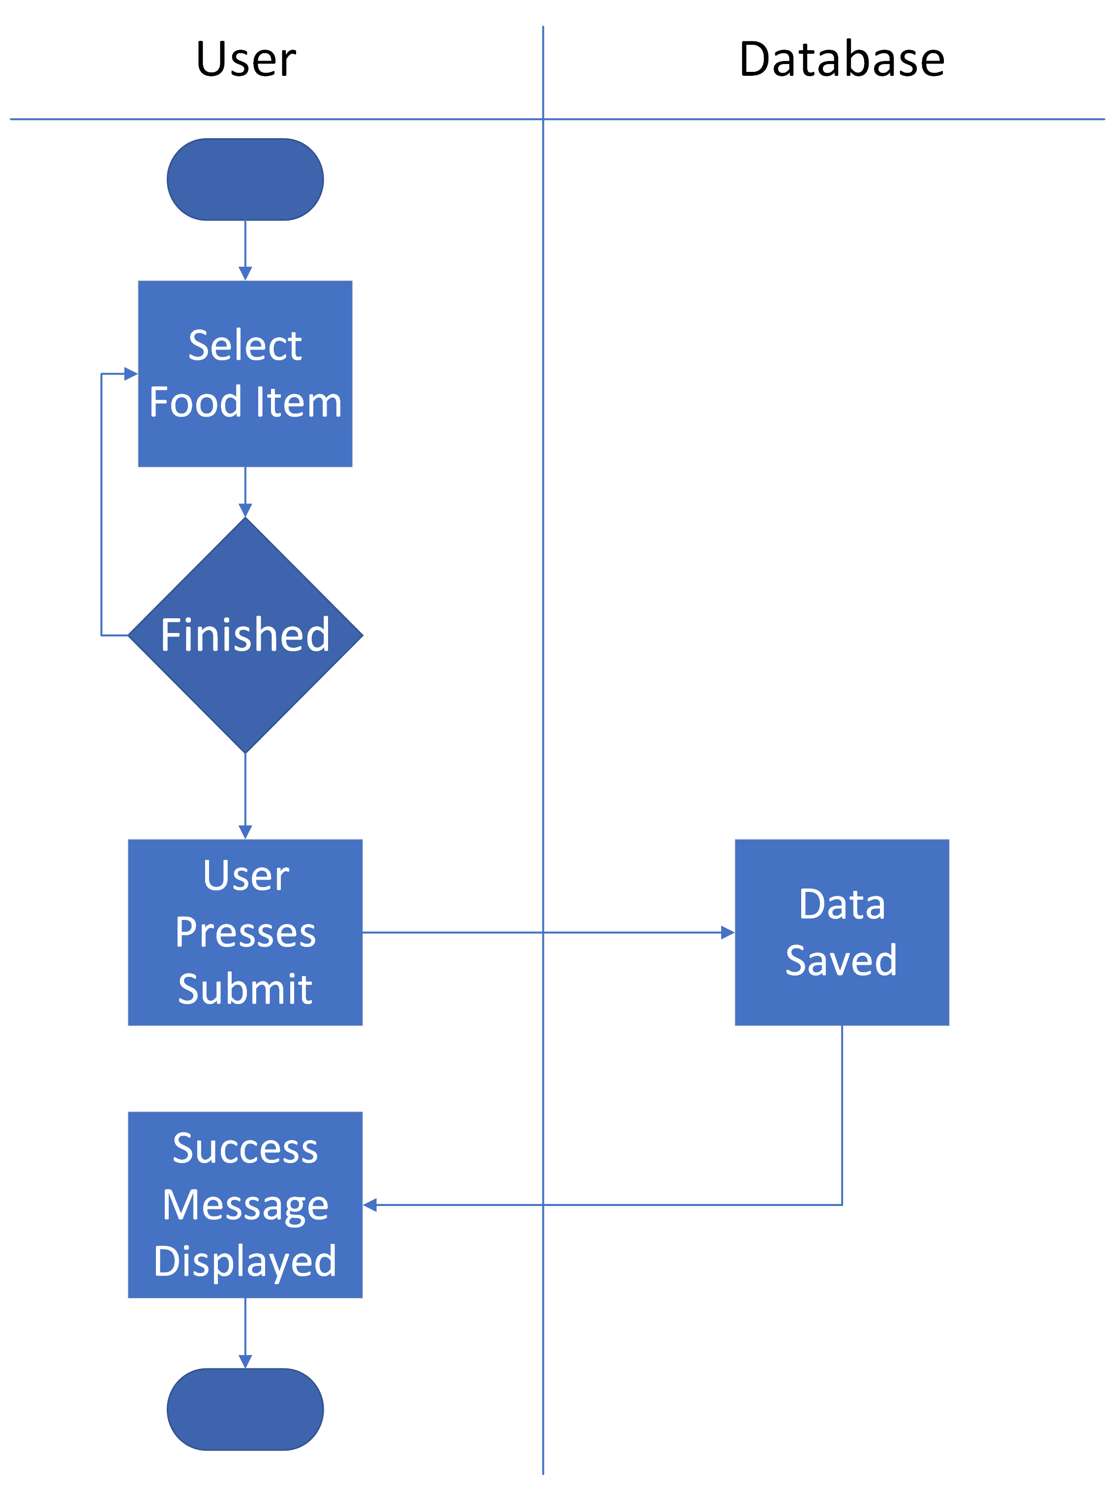
User Flow - Kiosk

Slide 13
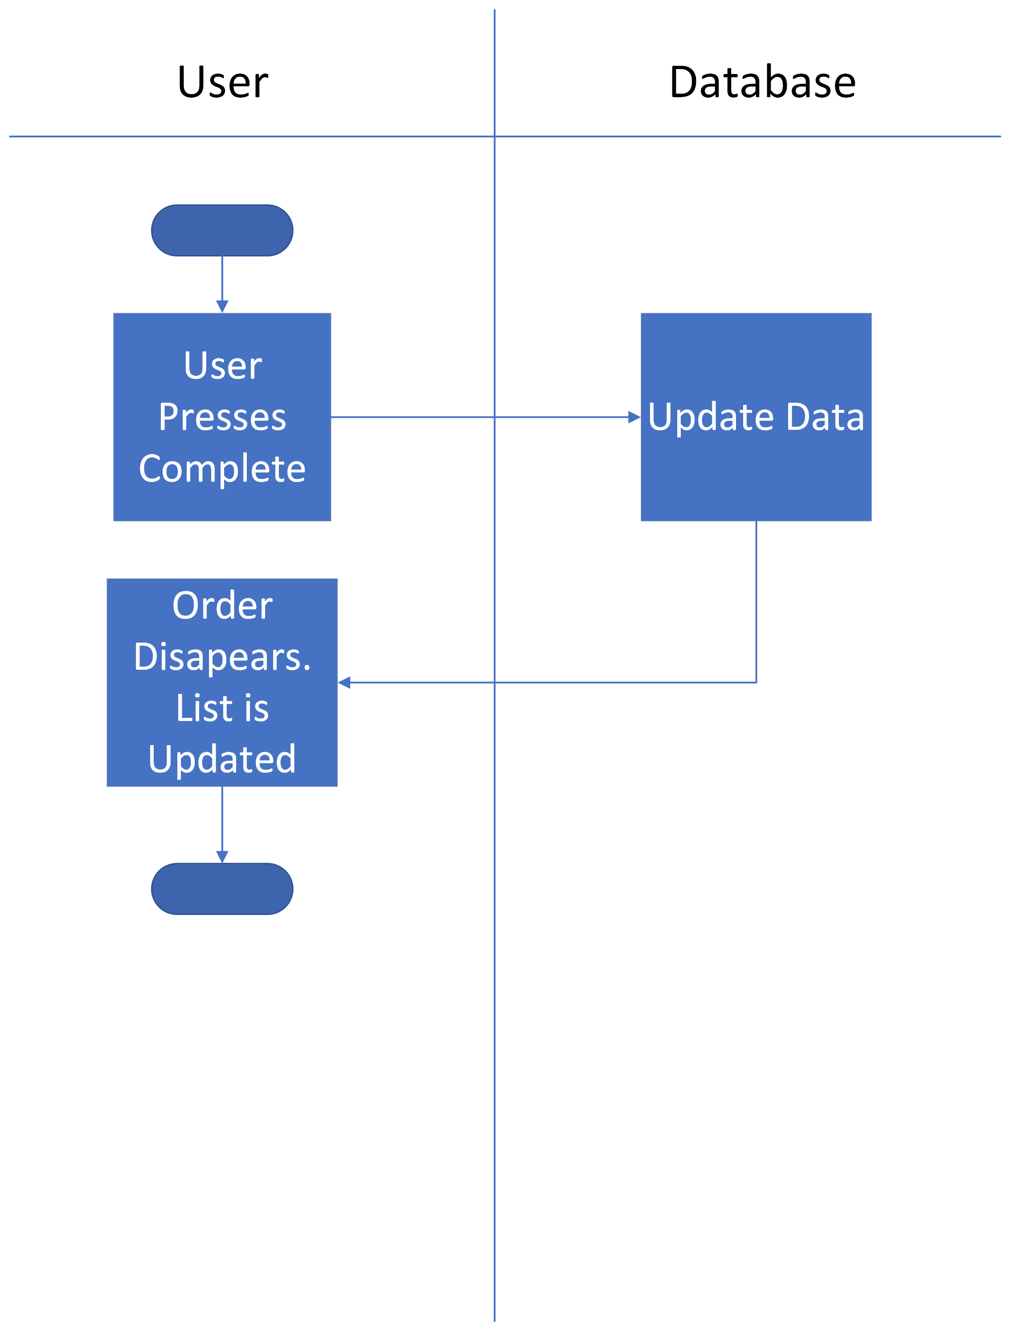
User Flow - Kitchen

Slide 14
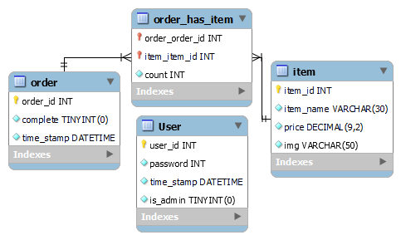
Database

Slide 15
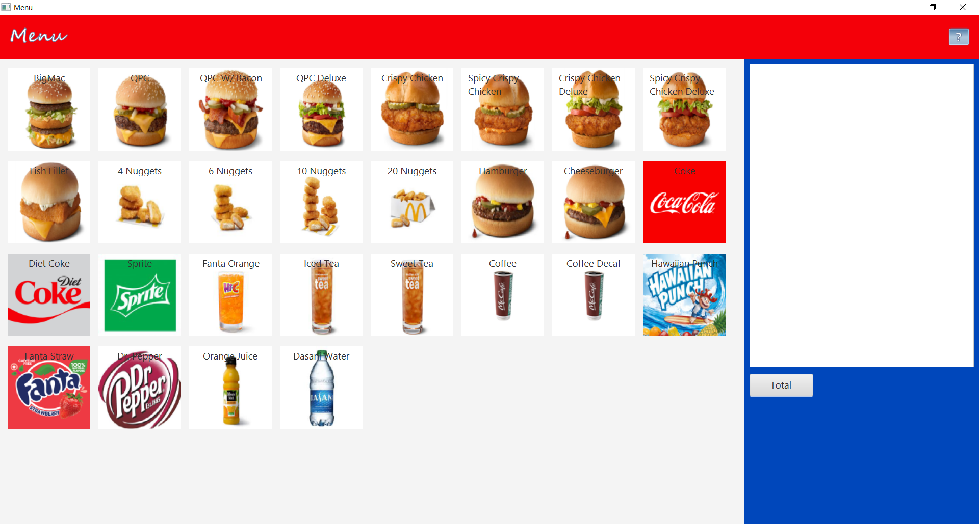
Screen Layout - Kiosk

Slide 16
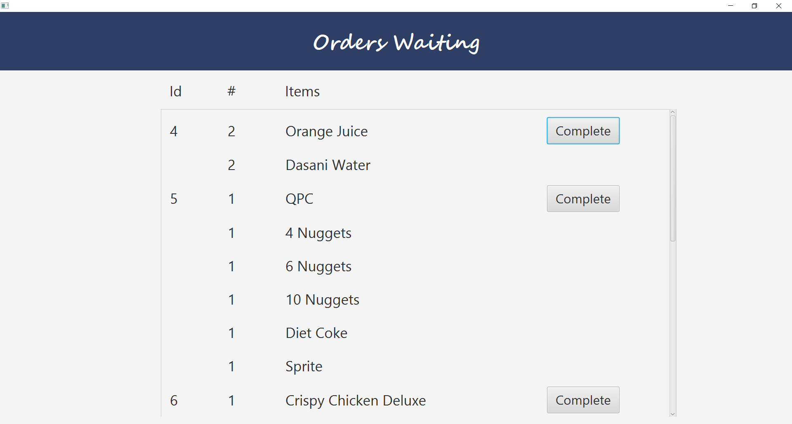
Screen Layout - Kitchen

Slide 17
Test Cases - Kiosk
User | Case # | Description | Expected Results | Actual Results
Customer | 1.1 | Pressing one of the item buttons on the kiosk. | The item name and price is displayed on the current order tab to the right.
 | 1.2 | Pressing the “submit” button when the order is complete. | Stores the order in the order table and displays message.

Slide 18
Test Cases - Kitchen
User | Case # | Description | Expected Results | Actual Results
Kitchen Staff | 2.1 | Update Order when kiosk submit button is pressed | Displays the orders in First In First Out order from the top of the Screen.
 | 2.2 | Pressing the “complete” button when the order is made. | Deletes the order from the screen and bumps up the next order to the top of the list.

Slide 19
Test Cases - kitchen
User | Case # | Description | Expected Results | Actual Results
Kitchen Staff | 2.3 | Timer refreshes list with current orders. | Current orders are kept to date every 15 seconds.

